Slide 1
Who was the ‘typical’ Australian in 2016? The ‘typical’ Australian is a 38 year old female. A decade ago, the ‘typical’ Australian would have been a year younger. In 1911 the ‘typical’ Aussie was a 24 year old male, but women have outnumbered men since 1979. The ‘typical’ Aboriginal and/or Torres Strait Islander person is also female, but she’s younger: 23 years old, in fact. The ‘typical’ Australian male or female was born in Australia, has English ancestry and parents also born in Australia. But while the ‘typical’ Australian has parents born in Australia, if you are from New South Wales, Victoria or Western Australia your actually most likely to have at least one parent who was born overseas. The ‘typical’ Aussie male is 37 years old and spends less than five hours a week on domestic work. The ‘typical’ Aussie female is 38 years old and spends between five and 14 hours a week on domestic work.
How do we know all this? Where does this information come from?
How can this information be used?
Notes:
Idea is to discuss the data and then ask the question, where does this data come from, is it reliable and what would this data be used for?

Slide 2
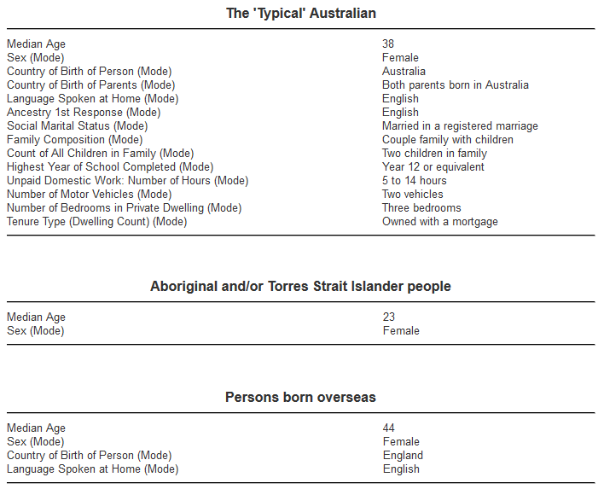
What are the 2 measures that were used to create this data?
Notes:
Discuss that in this case the median and the mode are the measures that were used to help determine the typical Aussie

Slide 3
Quick Write.
What do you think a Census is?
What are the advantages and disadvantages to a census?
What is the alternative?

Slide 4
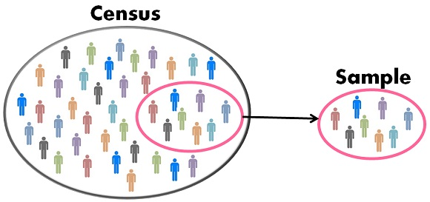
24
7
30
Date
Topic: Data
EQ – How can you create a fair survey of a population.
In a census, everyone in a population is surveyed.
In a sample, only a section of the population is surveyed. The larger the sample size, the more accurate it is.
A census is more accurate but samples are quicker and cheaper.
Examples.
A survey of year 9 students is conducted and everyone is asked to respond is an example of a census of all year 9 students.
A phone survey is conducted where every 20th person is called is an example of a sample.

Slide 5
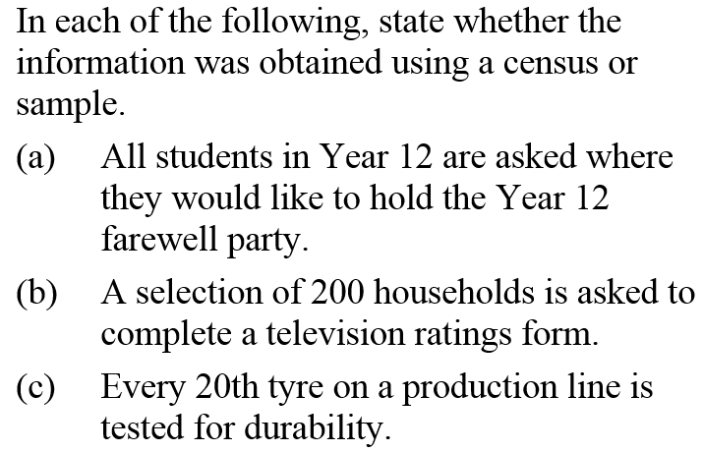
Example
a) Census b) Sample c) Sample

Slide 6
When conducting a sample it is important to choose your sample population carefully as under or over representing a section of a population will result in biased results.
Example.
A sample of 15 dance students concluded that all students like romantic comedies more than action movies.
A recent survey conducted at “Lakelands Retirement Centre” determined that “Antiques Roadshow” was Australia’s favourite tv show.

Slide 7
Complete the worksheet.
Discuss the answers with your neighbour and be prepared to share your answers with the class.

